Slide 1
Azure SQL Database
Nigel Ellis, Distinguished Engineer, Microsoft Data Platform Group nigele@microsoft.com February 2015

Slide 2



Data Platform Continuum
SQL Server
& APS / PDW
Azure
SQL Virtual Machines
Azure
SQL Database
DB
One consistent platform with common tools
Spectrum of traditional apps to cloud-only and hybrid solutions
Complementary choices for a variety of scenarios
Notes:
We have customers who run all their databases on-prem
We have customers who run all their databases in Azure SQL DB
We have customers who run all their databases in IaaS VMs in Azure or other places
But majority of our customers need a mix of all
Aside from human preferences, which may be all the reason you need, there are plenty of technical and business reasons that inform our customers choice on where to run a database -- our goal is to make the best of the SQL available where ever the customers needs it or desires it
Examples of capabilities “born in Azure” that goes to Box:
Azure DB -> IaaS and Box: QDS, database level collation, collation support for GB10303 (China), …
IaaS -> Azure DB and Box: XIO (remote storage), …
Box -> Azure DB and IaaS: Backup to Azure, …

Slide 3
SQL Database Service Overview
A relational database-as-a-service, fully managed by Microsoft
Built on SQL Server 2014 core engine
For cloud-designed apps when near-zero administration and enterprise-grade capabilities are key
Perfect for dramatically increasing the DB:IT ratio via programmatic DBA-like functionality
Elastic scale & performance
Business
continuity & data protection
Familiar & self-managed
Predictable performance levels
Programmatic scale-out
Dashboard views of DB metrics
Self-service restore
Disaster recovery
Compliance-enabled
Familiar tools
Programmatic
Self-managed

Slide 4
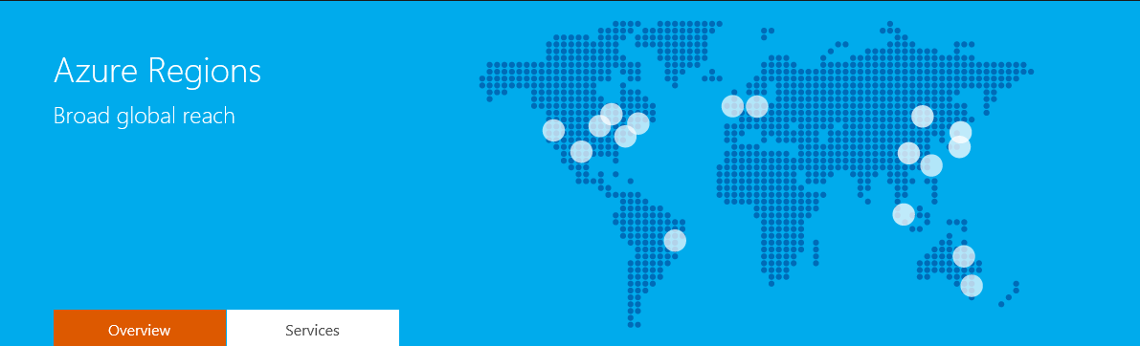
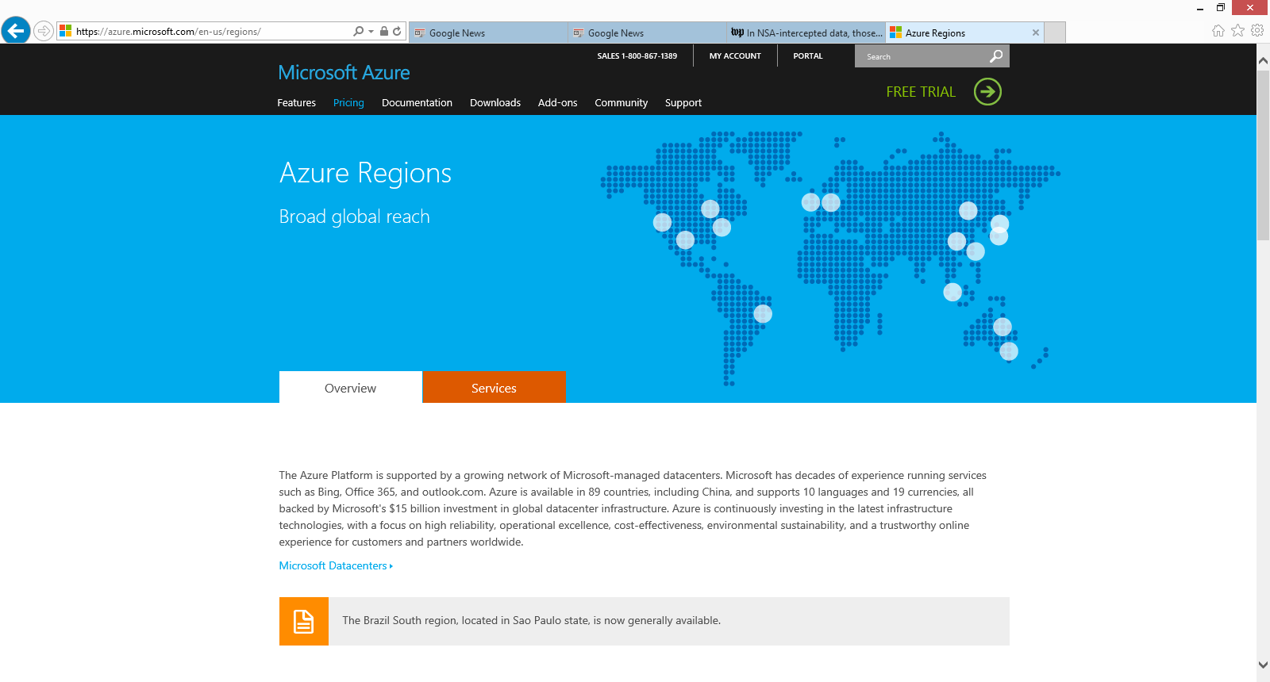
Where is it offered?
United States | US East & East 2 (Virginia) US West (California) US Central (Iowa) US North Central (Illinois) US South Central (Texas) US Gov (Iowa and Virginia)
Asia Pacific | Asia Pacific East (Hong Kong) Asia Pacific Southeast (Singapore) Australia East (Sydney) Australia SouthEast (Melbourne)
Japan | Japan East (Saitama Prefecture) Japan West (Osaka Prefecture)
Brazil | Brazil South (Sao Paulo State)
China | Beijing Shanghai
Europe | Europe North (Ireland) Europe West (Netherlands)
Notes:
Azure DB forms part of the Microsoft Azure platform – a comprehensive Cloud offering currently hosted in 18 points-of-presence around the globe. More regions are coming online as we speak.
http://azure.microsoft.com/en-us/regions/#services

Slide 5
Azure SQL DB Fun Facts
Our largest external customer has 114K databases over a month
Our largest internal customer creates 69K databases each week
Customers across 133 countries use Azure SQL DB
296,000,000 logins occurred in the busiest day last week
160,000 peak database creates/drops in a day
64 active clusters in 19 datacenters around the globe

Slide 6













What are customers doing with SQL Database?
ISVs and CSVs
Enterprise Apps Designed for Cloud
Modernize Existing Enterprise Apps
Multi-tenant software application
Rebuild on Azure for cost-effective scale
Blend SQL Database tiers, 1,000s of DBs
Multi or single tenant application
Designed for elasticity & Big Data
Blend Azure services, SQL DB Premium
Existing Web LOB or packaged application
Remove CAPEX, reduce OPEX
Websites & SQL Database Premium

Slide 7
Azure SQL Database Service Tiers
 | Basic | Standard | Premium
Built for… | Light transactional workloads | Medium transactional workloads | Heavy transactional workloads
Availability SLA | 99.99%*
Database Max Size | 2 GB | 250 GB | 500 GB
Point-in-time Restore | Any point within 7 days | Any point within 14 days | Any point within 35 days
Business Continuity | Geo-Restore | Standard Geo-Replication | Active Geo-Replication
Security | Auditing
Database Throughput Units | Basic: 5 | S0: 10 S1: 20 S2: 50 S3: 100 | P1: 100 P2: 200 P3: 800
Available tiers ($/month) | Basic: $4.99 | S0: $15 S1: $30 S2: $75 S3: $150 (in preview on V12) | P1: $465 P2: $930 P3: $3720
Notes:
Based on customer feedback, Azure SQL Database is introducing new service tiers to help customers more easily innovate with cloud-designed database workloads. At the heart of this change, the new tiers deliver predictable performance across a spectrum of six performance levels for light- to heavy-weight transactional application demands. Additionally, the new tiers offer a spectrum of business continuity features, a stronger uptime SLA, larger database sizes for less money, and an improved billing experience.
CSV purchase model:
What Web and Business did – allowed databases to spike as needed w/o requiring proactive administration (scale up or down)
Customer databases inactive to active at varying times
Service to inherently support peaks in customer DB activity
Low cost DB when customer databases are inactive

Slide 8
Predictable performance levels
Redefined
Across the service tiers, each performance level is assigned a defined level of throughput for a streamlined experience
Measure of power
Introducing the Database Throughput Unit (DTU) which represents database power and replaces hardware specs
% CPU
DTU is defined by the bounding box for the resources required by a database workload and measures power across the six performance levels.
% read
% write
Basic — 5 DTU
S0 — 10 DTU
S1 — 20 DTU
S2 — 50 DTU
S3 — 100 DTU
P1 — 100 DTU
P2 — 200 DTU
P3 — 800 DTU
% memory

Slide 9
Data Protection
Disaster Recovery
Geo-Restore
Geo-Redundant Backup
RPO < 1 hour
Recovery Time Minutes to Hours
Included for
*all* databases
Geo-Replication
Asynchronous replication to a regional Data center
RPO < 5 seconds
Recovery Time
< 30 seconds
Available for Standard & Premium
Oops Recovery
Point in time restore
(PITR)
Continuous backup with tiered retention period
Restore to any-point
Recovery Time Minutes to Hours
Included for
*all* databases
Accidental Database deletion
Tail-end backup
Restore to point of deletion
Recovery Time Minutes to Hours
Included for
*all* databases

Slide 10

Point-in-time restore
Programmatic “oops recovery” of data deletion or alteration
Auto backups, transactional logs every 5 min
Backups in Azure Storage and geo-replicated
Creates a side-by-side database copy, non-disruptive
REST API, PowerShell or Azure Portal
Scheduled exports for long-term retention
Backups retention policy:
Basic, up to 7 days
Standard, up to 14 days
Premium, up to 35 days
SQL Database Backups
Azure Storage
Geo- replicated
sabcp01bl21
sabcp01bl21
Restore from backup

Slide 11
Demo: PITR
Demo of “Whoops recovery”

Slide 12
Standard geo-replication
Opt-in business continuity for greater geo-redundancies
Opt-in with Standard and Premium
Creates passive secondary
Replicate to pre-paired Azure region
Automatic data replication, asynchronous
Opt-in via REST API, PowerShell or Azure Portal
Geo- replicated

Slide 13
Active geo-replication
Mission-critical business continuity on your terms, via programmatic APIs
Self-service activation in Premium
Create up to 4 readable secondaries
Replicate to any Azure region
Automatic data replication, asynchronous
REST API, PowerShell or Azure Portal
Up to 4 secondaries

Slide 14
Active GeoDR
DEMO: Active Geo Replication with readable secondaries

Slide 15
Team Mission
Deliver the best DB service on the planet
Incorporate key learnings from running Azure DB @ scale for past 4 years (1M databases!)
Integrate with the best of Azure - 4 years of Azure ecosystem evolution since start of Azure DB
Enterprise grade SQL with full box compatibility
Truly deliver on the promise of PaaS elasticity and auto-management with no compromise
Continue improving service no customer impact
Maintain existing service compatibility
Obsess about customers
Use data insights to drive decisions

Slide 16
Azure SQL Database V12
Better support for large databases
Table partitioning + parallel queries
Online + large index rebuild
Europe GA on: Jan-29-2015
US GA on: Feb-9-2015
World-wide GA by: March-2015
Expanded programming surface area
Command Language Runtime (CLR) + XML index
T-SQL Windows functions + change tracking
Deeper database insights
Extended Events
Over 100 new Database Management Views (DMVs)
Greater performance for data marts
Clustered and non-clustered columnstore index support for data marts and analytics
Notes:
Top Themes for v12:
Take a big step towards closing the T-SQL compatibility gap between Azure SQL DB and SQL Server
Better premium performance
New architecture
SQL core engine upgraded from SQL 2012 to SQL 2014++

Slide 17
App Compat
DEMO: v11 vs. v12 App Compatibility

Slide 18
Improved Compatibility and New Features
Better database manageability
Table partitioning
Large index rebuild
Online index build/rebuild with LOB column
2GB transaction size limit is removed
CHECKPOINT support
ALTER DATABASE command
Non-admin DBCC commands
Page and row level compression
Programmability and application support
Analytic Window Functions
CLR Support
XML index
Heap Support & SELECT INTO
Application roles
Change Tracking
UTF-16 support
Sequence Objects
Deeper customer Insight into their database
Session events (XEvents)
Extended DMV set (select DMVs)
Improved Premium performance
Clustered and non-Clustered Column Store Indexes
Parallel queries
Lower latency IO (running on SSD based SKUs

Slide 19
Performance
“We are already using this platform in a production environment (meanwhile, in parallel to our prev. solution)… Our previous DB platform was on AWS RDS, because the previous Azure SQL DB performance was not enough for our loads, and we are happy to move to Azure SQL…”
Higher DTU rating for Premium V12 DBs
Premium databases runs on SSD
10x IOPS for Premium SKUs
Improved replication stack → better write perf
Over 2x improvement in log throughput
Up to 100x query performance improvement with Compression and In-memory Columnstore Indexes
…We took our most demanding customer and set it up so that it would write data to both Azure SQL DB and Sterling. The data load was averaging 200 records per second (24 hours a day, 7 days a week). We loaded a little over 1 billion records into both Azure SQL DB and Sterling and while we still had performance issues with [current] Azure SQL DB, we had no performance issues with Sterling…

Slide 20
Raw performance: v11 vs. v12
Demo: getting extra perf in Premium SKUs for the same price

Slide 21
Getting to v12 – codename “Sterling”
Project starts in 2006 with CloudDB
Targets internal MSFT SQL storage needs (Windows Live Spaces, Exchange Hosted Archive)
Dedicated cluster for single-tenant use
SQL Azure debuts in 2009 built on CloudDB
“single tenant” backend with gateway/proxy layer presents DB user model
Periodic upgrade of service internals across SQL Server versions (last version on SQL 2012)
Continuous improvement to HA/DR system with focus on predictable performance
Azure DB editions in 2014 (new biz model)
Azure DB v12 GA Jan 2015
Huge improvement in the service infrastructure; integrates the best of Azure and SQL Server 2014
Delivers bump in DB version from v1 to v12 – huge step up in app-compat and performance

Slide 22
Sterling Pillars
Azure SQL DB Current
Keep logical svr/db model of Azure DB Enable full compatibility for Azure DB “Standard” and “Premium” business models
SQL 14
AlwaysOn
Replace logical (CloudDB) replication layer with AlwaysOn physical (log) replication
SQL 14
WA Blob Storage
Enable remote databases over WAS (SQL14) Use to host cold/small and eventually hybrid workloads. Larger scale too with remote
Windows Fabric
Replace managed Fabric layer with WinFab
Adopt the WinFab service model
Implement tenant isolation (governance + security)
Benefits
Solid foundation building on common SQL 14 engine investments (SMP+MPP)
Enables faster path to value via. better componentization and code velocity
Robustness, Performance, Scale, Density → overall cost reduction leading to higher margin
Foundation on next gen HW and workload investments (support for data warehousing too)
Enables significant savings in operational costs and improved resource utilization pan-Azure
Notes:
Core Focus Areas:
Customer Isolation for security, performance predictability, OS leverage and enabling increased box compatibility
Leverage the Azure ecosystem for lower COGS, smaller team, faster innovation
Support local and remote storage as step towards hybrid storage
Telemetry driven development, 100% DevOps, Test/Dev merge

Slide 23
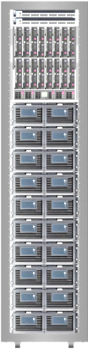

Database High Availability
Majority quorum up to 4 replicas
Transparent automatic failover
Uptime SLA of 99.99%
Zero user or admin config
Single Logical
Database
DB
Read
Ack
Write
P
P
Ack
Ack
S
S
S
S
Write
Write
Reads are completed at the primary
Writes are replicated to secondaries
Notes:
Protection against system failures
Each database is protected by up to 4 replicas
User sees a logical database, abstraction over a primary and a set of up to 4 replicas
Reads are served directly from the primary
Updates are applied to the primary and then to the replicas. The system is synchronous – blocking until a majority quorum (n/2+1) replicas acknowledges the update. The system then responds to the client. Remaining replicas are updated asynchronously
If an error on a node occurs the system detects this and fails over automatically making one of the secondaries a primary. If ever multiple nodes fail simultaneously and there is danger of a quorum loss the system will prevent further access to the database until quorum is restored. In the event of replica loss due to hardware failure the system automatically creates new copies on alternate nodes

Slide 24
Deployment Rollout in Action
Racks equal to Fault Domain. Upgrade Domains span all Fault Domains.
Upgrade Process
1. Takes down the first upgrade domain and updates software. This can only affect one replica.
Placement Process
1. Pick any node for first replica. That results in that Fault Domain and Upgrade Domain being unavailable for other replicas.
2. First UD is brought back up and waits for the machines to come back healthy. Then second UD is shut down.
2. Pick the second replica from any node not already disqualified. This excludes another FD and UD.
3. Repeat until all UDs have been upgraded.
3. Repeat until you have placed the required number of replicas.
Note: Upgrades can withstand a simultaneous fault domain failure with high enough spare capacity and replica count
Notes:
Machine sizes and scale of data
Typical clusters hosts 300 – 800 nodes (depends on location and generation of hardware)
Upgrades and pace of deployment
Updates and change management is a fact of life in the cloud. We typically push multiple updates to each environment weekly.

Slide 25
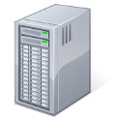
Azure SQL DB V12: Azure Region View
Customer App
Customer App
SQL Client
SQL Client
Region Control Ring
TDS
Redirection
Database Tenant Ring A
Database Tenant Ring B

Slide 26
How Connections Work
Client Application
Redirected to: IPN:11267
Logical Server + DB
myserv.database.windows.net, TestDB1
IP1:1433
Azure Region
Control Ring
IPN:11267
Connection is redirected via. TDS protocol
Supported on up-level clients: SNAC, ADO.Net
PHP, JDBC, etc. coming soon
In cases where outbound ports are blocked, we support proxy connection via. control cluster
IP2:11000-12000
IPN:11000-12000
DB Ring 1
DB Ring N
S
S
…
S
S
P
S
P
S
IPN:11267

Slide 27
Local and Remote Storage Support
Control Service is entry and redirection point
Local/Remote storage hidden from customer: decision based on SLO tier / workload
Local storage – very low latency: 1ms, 50k IOPS, 1TB
Remote storage – network hop 40ms, ∞ IOPS, ∞ size
“Tenant“ XStore Storage
XStore
XStore Geo-repl
XStore
App
REST
“Control“ Ring
Data files
Backups, telemetry
TDS
AlwaysOn
Geo-repl
AlwaysOn
local-repl
Notes:
Database is a failover unit managed by Windows Fabric
Either local storage using 4 stateful replicas (can shift down to 2 for upgrade/failures)
1 remote over XStore page blobs built on SQL-XI feature from SQL14
Switch between formats or SLOs is online via AlwaysOn streaming physical seeding (database backup/restore)
Replication is based on physical SQL log stream
DR copies can be setup by system (Standard) or customer (Premium – up to 4 targets)
Single log stream cross DR copies with additional copies maintained on the target
Northstar: Hybrid / Tiered Storage
Multiple scenarios call for cheap cold storage COGs (pay nothing when idle) and fast local attached performance:
OLTP (in-mem or page based), latency sensitive
Data warehousing, throughput and bandwidth sensitive
We think the sweet spot is a hybrid of 2 local + 1 remote
Also likely to use tiering via SQL buffer pool extensions over remote

Slide 28
SQL Platform Continuum
SQL Server & APS / PDW
Azure
SQL Virtual Machines
Azure
SQL Database
DB
Cloud 1st but not Cloud Only
Using Azure SQL DB to improve core SQL Server (features/cadence)
Products and Services all delivered from common code branch
Many interesting (and compelling) on-premises ←→ Cloud scenarios
Notes:
We have customers who run all their databases on-prem
We have customers who run all their databases in Azure SQL DB
We have customers who run all their databases in IaaS VMs in Azure or other places
But majority of our customers need a mix of all
Aside from human preferences, which may be all the reason you need, there are plenty of technical and business reasons that inform our customers choice on where to run a database -- our goal is to make the best of the SQL available where ever the customers needs it or desires it
Examples of capabilities “born in Azure” that goes to Box:
Azure DB -> IaaS and Box: QDS, database level collation, collation support for GB10303 (China), …
IaaS -> Azure DB and Box: XIO (remote storage), …
Box -> Azure DB and IaaS: Backup to Azure, …

Slide 29
Thank you

Slide 30
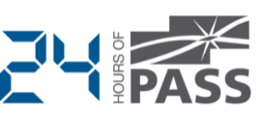









Explore Everything PASS Has to Offer
Free SQL Server and BI Web Events
Free 1-day Training Events
Regional Event
This is Community
Business Analytics Training
Local User Groups Around the World
Session Recordings
PASS Newsletter
Free Online Technical Training

Slide 31

© 2014 Microsoft Corporation. All rights reserved. Microsoft, Windows, Windows Vista and other product names are or may be registered trademarks and/or trademarks in the U.S. and/or other countries.
The information herein is for informational purposes only and represents the current view of Microsoft Corporation as of the date of this presentation. Because Microsoft must respond to changing market
conditions, it should not be interpreted to be a commitment on the part of Microsoft, and Microsoft cannot guarantee the accuracy of any information provided after the date of this presentation.
MICROSOFT MAKES NO WARRANTIES, EXPRESS, IMPLIED OR STATUTORY, AS TO THE INFORMATION IN THIS PRESENTATION.

